Slide 1
Quantum Steganography for Hiding Secret Text
Presentation by: Mitesh Adake
Roll No.: 31401
Seminar Guide: Prof. P. J. Jambhulkar
Domain: Quantum Computing

Slide 2
CONTENT
PROBLEM DEFINITION
INTRODUCTION
MOTIVATION
LITERATURE SURVEY
SOFTWARE and HARDWARE REQUIREMENTS
BLOCK DIAGRAM
BB84 PROTOCOL
IMPLEMENTATION
FUTURE SCOPE
CONCLUSION
REFERENCES

Slide 3
PROBLEM DEFINITION
To implement Quantum Steganography Protocol to hide secret text in cover data.
Keywords :- Quantum Mechanics, Quantum Communication, Quantum Key Distribution, Cryptography, Hidden Data, Qubit

Slide 4
INTRODUCTION
Quantum Computing is bleeding-edge technology, which uses quantum mechanical properties to compute .
With its exponential power of computation, future is just decade away from breaking RSA encryption and Elliptic Curve Cryptography.
Steganography + Quantum Key Distribution(BB84 Protocol)

Slide 5
MOTIVATION
Recently the rise of privacy and data security has gained massive attention. Peer-to-peer communication can be vulnerable to various attacks. Using quantum mechanical properties in computer can help enhance the security.
Quantum properties of qubit do not allow eavesdropper to keep transcript of quantum signals in the process of quantum key distribution. With potential of qubits to exhibit superposition and entanglement, which reduces the vulnerability of the key distribution.
Quantum Computers have the ability to enhance the privacy of data with its properties of superposition, entanglement and no-cloning theorem.

Slide 6
LITERATURE SURVEY
No. | Paper Title | Summary | Limitations
1 | Why Quantum Steganography Can Be Stronger Than Classical Steganography | Extended the model of classical steganography and showed quantum steganography model can be secure than classical model | Building a quantum steganography model while Noisy Intermediate-Scale Quantum(NISQ) era is difficult.
2 | Steganography Protocols for Quantum Channels | Showed that quantum channels are more diverse than classical channels | Practical implementation with current number of qubits

Slide 7
No. | Paper Title | Summary | Limitations
3 | Quantum Steganography Embedded Any Secret Text without Changing the Content of Cover Data | Proposed a quantum steganography protocol embedding a secret message in plain text. Describes about various steps/alternatives to implement the proposed protocol. | Mathematical model without actual implementation. Requires in advance sharing of quantum keys.

Slide 8
SOFTWARE and HARDWARE REQUIREMENTS
SOFTWARE REQUIREMENTS:
Jupyter Notebook
Qiskit - 0.27.0
Python - 3.5 or above
HARDWARE REQUIREMENTS:
Core i5 or i7 machine

Slide 9
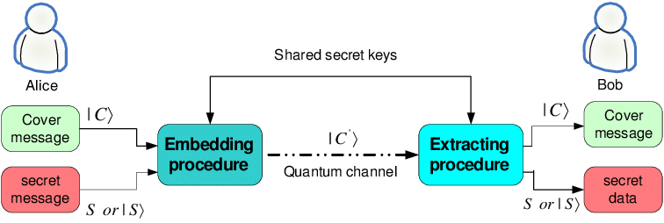
BLOCK DIAGRAM

Slide 10
BB84 PROTOCOL
Algorithm -
Consider two parties: Alice and Bob.
SELECT ENCODING: Alice randomly selects a basis ( × or + ) to encode each bit.
SELECT MEASUREMENT: Bob randomly selects a basis ( × or + ) to measure each
ENCODING: Alice creates the quantum states encoded in the selected bases.
SENDING: Alice sends Bob the encoded states via the quantum channel.
MEASUREMENT: Bob measures the quantum states in his pre-selected measurement bases.
SEND BASES: Alice send which basis were used to encode each bit via the classical channel.
FIND SYMMETRIC KEY: Alice and Bob discard bits in their key that used a different encoding and decoding basis.

Slide 11
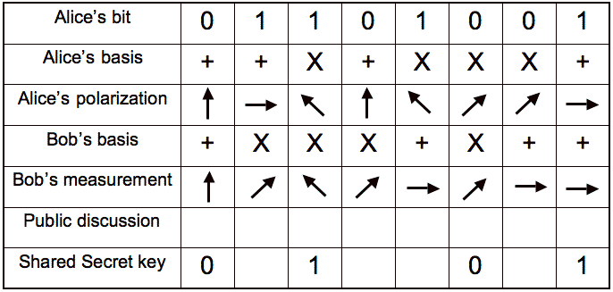

Slide 12
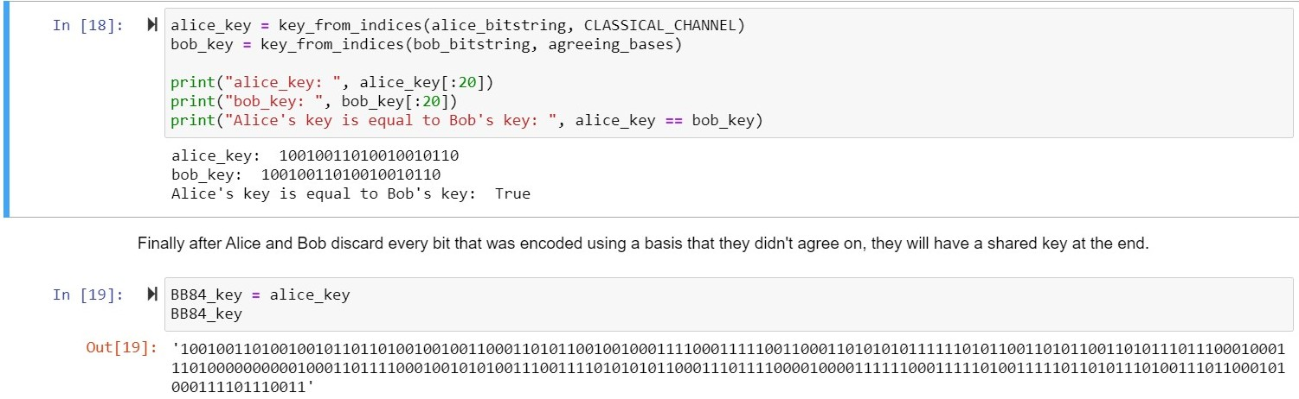
IMPLEMENTATION
BB84 Protocol -

Slide 13
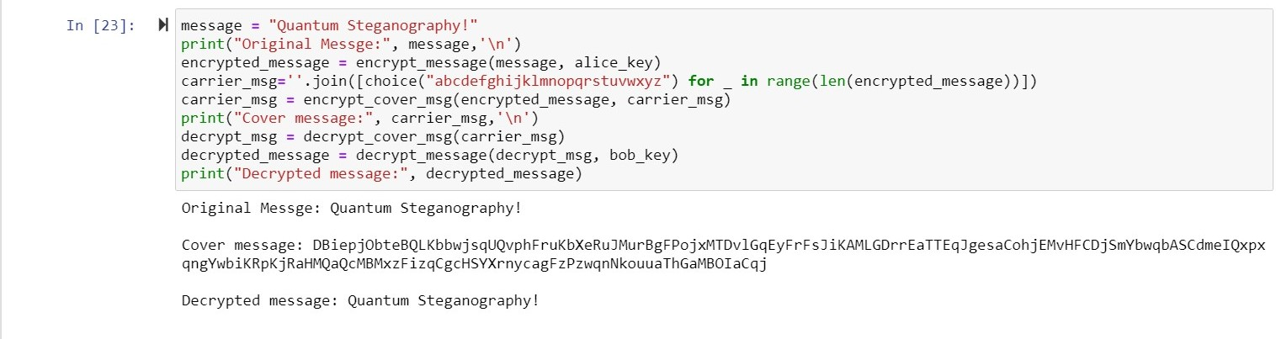
2. Embedding secret text in cover message -

Slide 14
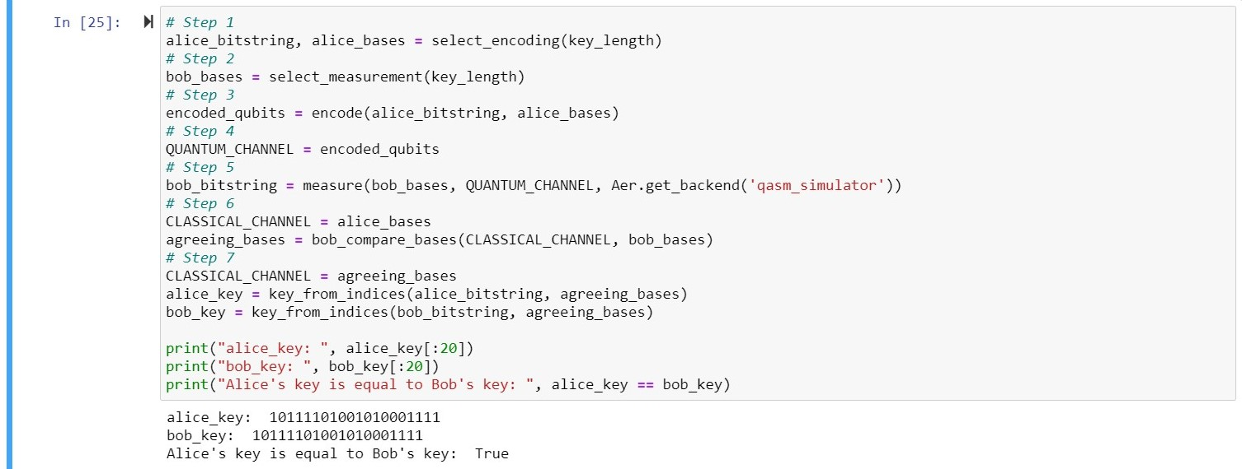
3. Complete Protocol -

Slide 15
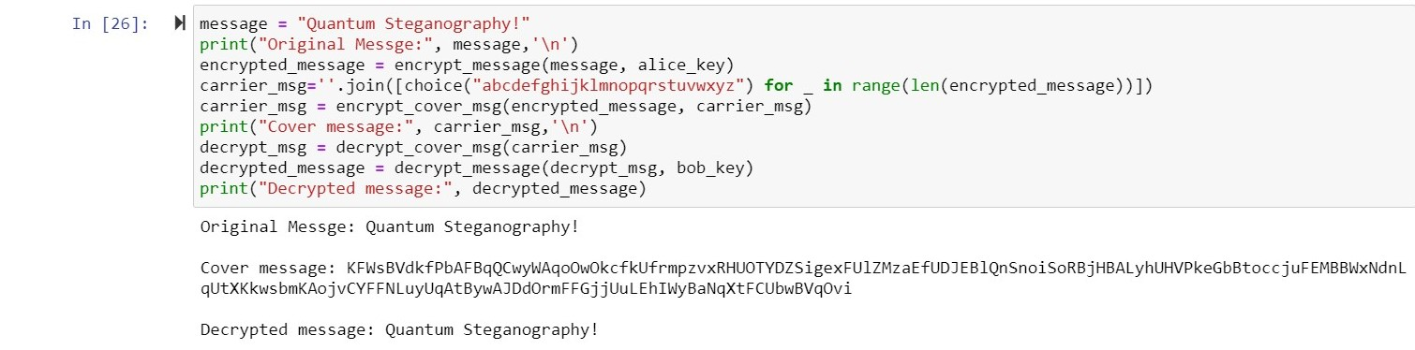

Slide 16
FUTURE SCOPE
Files types-
This protocol can be extended for other type of files such as image, audio and video.
Errors -
To reduce the errors in the quantum channel, Quantum Error Correction code can be written for running this protocol on a quantum hardware.
Number of qubits required-
It is observed that the length of encrypted message is directly proportional to cover text, thus an efficient protocol to reduce the length of encrypted message can be implemented.

Slide 17
CONCLUSION
A quantum steganography model is successfully implemented to hide the secret text with the cover message. The model is able to generate different shared keys between the two parties and could embed the secret message into the cover message. The quantum steganography protocol was implemented on a simulator, without any error in the qubits’ states. Thus, the protocol works for noiseless quantum computer.

Slide 18
References
[1] M. Tahmasbi and M. R. Bloch, ”Steganography Protocols for Quantum Channels,” 2019 IEEE International Symposium on Information Theory (ISIT), 2019, pp. 2179-2183, doi: 10.1109/ISIT.2019.8849593
[2] C. H. Bennett and G. Brassard, ”Quantum cryptography: Public key distribution and coin tossing”, Theor. Comput. Sci., vol. 560, pp. 7-11, 2014.
[3] Takashi Mihara, “Quantum Steganography Embedded Any Secret Text without Changing the Content of Cover Data”, Journal of Quantum Information Science Vol.2 N0.1, 2012.
[4] S. Natori, “Why Quantum Steganography Can Be Stronger than Classical Steganography,” Quantum Computation and Information, Vol. 102, 2006, pp. 235-240, 2006.
[5] Christian Cachin, “An information-theoretic model for steganography”, Information and Computation, Volume 192, Issue 1, 2004.
[6] A. A. A. El-Latif, B. Abd-El-Atty, M. S. Hossain, S. Elmougy and A. Ghoneim, ”Secure Quantum Steganography Protocol for Fog Cloud Internet of Things,” in IEEE Access, vol. 6, pp. 10332-10340, 2018, doi: 10.1109/ACCESS.2018.2799879

